Slide 1
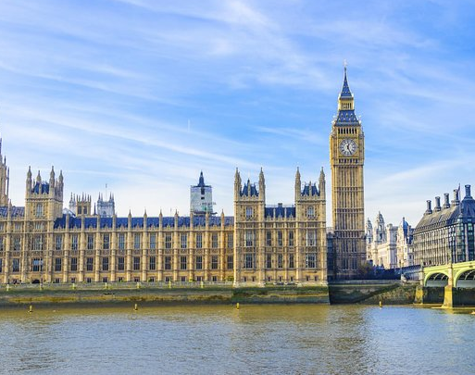
Westminster Shorter Catechism
Questions 11 - 13
February 14, 2021
Calvary OPC, La Mirada, CA

Slide 2
Question #10
Q. How did God create man?
A. God created man male and female, after his own image, in knowledge, righteousness, and holiness, with dominion over the creatures.

Slide 3
What does the Bible say?
"26 Then God said, 'Let Us make man in Our image, according to Our likeness; let them have dominion over the fish of the sea, over the birds of the air, and over the cattle, over all the earth and over every creeping thing that creeps on the earth.' 27 So God created man in His own image; in the image of God He created him; male and female He created them. 28 Then God blessed them, and God said to them, 'Be fruitful and multiply; fill the earth and subdue it; have dominion over the fish of the sea, over the birds of the air, and over every living thing that moves on the earth.'" (Genesis 1:26-27)

Slide 4
Not by evolution
They are still looking for missing links between apes and humans
Homo naledi (2010)
Homo luzonensis (2019)
Some Neanderthal facts
Genome is 99% similar to humans
Brain larger than ours
High cognitive skills (hunting, diving for shellfish)
Art and religion
Central genetic database calls Neanderthals Homo sapiens neanderthalensis
Likely had illnesses
There are mixed Neanderthal and modern human bones
23andme will tell you what % Neanderthal DNA you have

Slide 5
In God's image
Q: was Adam just like God in every way?
Q: list some communicable and incommunicable attributes!
Adam's original perfection is the goal of salvation
It also is the basis of anthropology
I.e. secular psychology versus biblical counseling

Slide 6
Knowledge
Adam exercised his role as prophet.
God revealed truth to man in the garden and Adam was capable of understanding His revelation perfectly.
No need to form hypotheses or test God's revelation.
When Adam named the animals, he didn't make up names, but rather described them according to their true nature.
As prophets we need to fore-tell God's Word
Q: why are there no prophets anymore today?
"…in thy light shall we see light" (Psalm 36:9)

Slide 7
Righteousness
Adam exercised his role as priest.
Adam was without sin, in a perfect world, without illness or disease.
This is the model God had in mind for us as humans
By default we are to do what is right all the time
Read Luke 17:7-10
This is the covenant of works
Q: is the covenant of works still in effect? Why or why not?
"Let your heart therefor be perfect" (1Kings 8:61)

Slide 8
Holiness
Adam exercised his role as king.
Adam represents God by having dominion over the creatures.
Holiness means
Without sin, spot or blemish
Perfection and completion
"This is the way, walk you in it" (Isaiah 30:21)

Slide 9
Question #11
Q. What are God's works of providence?
A. God's works of providence are, his most holy, wise, and powerful preserving and governing all his creatures and all their actions.

Slide 10
What does the Bible say?
"The Lord is righteous in all His ways, holy in all His works." (Psalm 145:17)
"Are not two sparrows sold for a copper coin? And not one of them falls to the ground apart from your Father’s will." (Matthew 10:29)
"Upholding all things by the word of his power." (Hebrews 1:3)

Slide 11
Preserving
God did not just wind up the world, let it go and then retire to some far corner of the universe (contra Deism).
God not only creates but also actively preserves and governs nature.
Natural disasters/difficult situations are all in God's sovereign control
i.e. the defeat of the Spanish Armada in 1588 with 132 ships and 28,000 troops against Protestant England
Southern generals marched bravely into battle knowing when their time to die would come
Q: think of other historical events that were under God's control
This is great encouragement!
Read Psalm 91:7! Psalm 46:1-2!

Slide 12
Governing
Evolutionary thinking has infected our view of history as well
Many people think that historical events are random, chance events
On the contrary, they all go according to God's foreordained plans
"And He changes the times and the seasons; He removes kings and raises up kings" (Daniel 2:21)
Not only that, God controls even the sparrows and knows the hairs on our heads
Q: Would you counsel someone who lost a loved one by emphasizing God's sovereignity?
Read Romans 8:28

Slide 13
God's decrees
"In Him also we have obtained an inheritance, being predestined according to the purpose of Him who works all things according to the counsel of His will" (Ephesians 1:11)
Before time God decreed what would happen
He didn't make mistakes or changes
He didn't deliberate or make drawings at whiteboard
GOD DECREED
Now, in history, God ACTS. God is pure act (purus actus)
We can therefore take great comfort in God's promises because God does not change!!

Slide 14
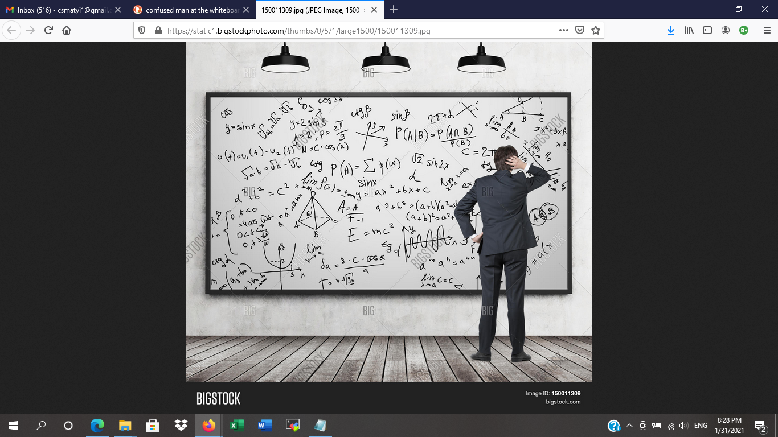

Slide 15
Molinism (middle knowledge)
Named after Luis de Molina, 16th century Jesuit
Used to counter Calvinism, Molinism states that human will is independent of the actions of God
God designs millions and millions of worlds, and chooses the best of all worlds where the most people are saved
Places ultimate responsibility on man
God merely reacts to humans
Virtually the same as Arminianism
Molinism's god

Slide 16
God decrees and acts
God is absolute
God is pure being
All things relate to God
God determines all things
God decrees
God carries out His decrees
God is pure act
God works in history
History is nothing less than the acts of God

Slide 17
More Bible verses
1Samuel 2:6-8
Proverbs 16:1, Proverbs 21:1
God is sovereign over the free actions of men
Q: Is man responsible for what he does if God controls all things?
Philippians 2:12-13
Q: Why is it that God controls even the little things?

Slide 18
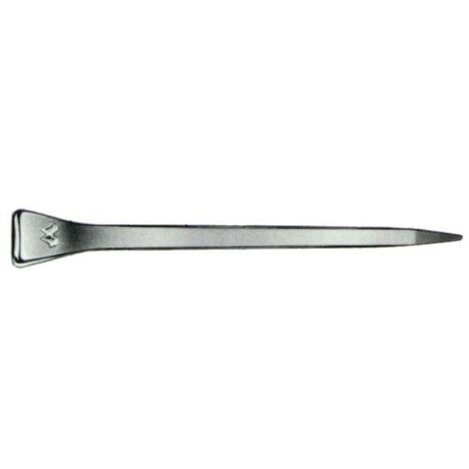
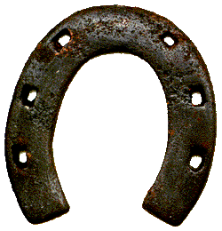
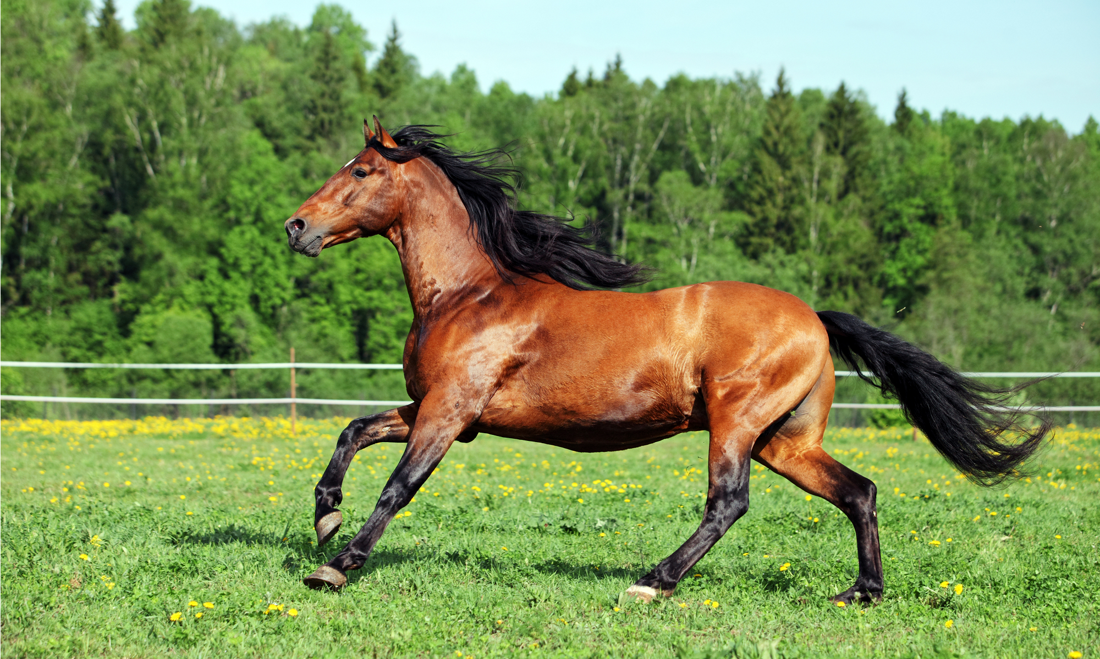
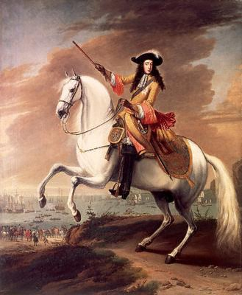
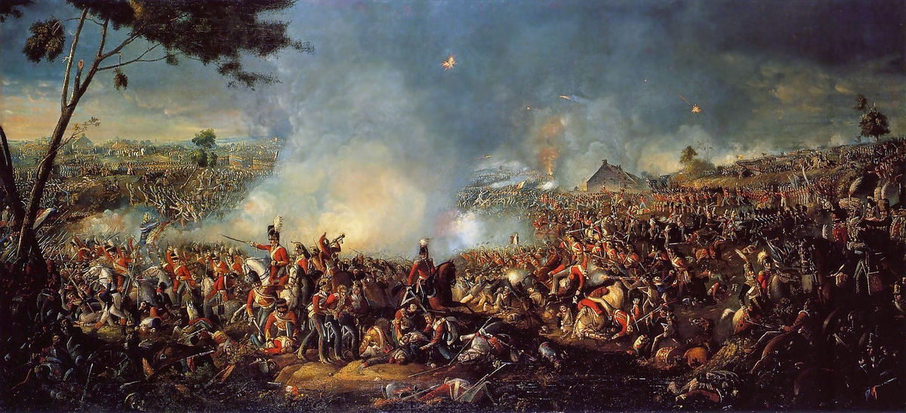
For want of a nail...
If small things are not under God's control, neither are big things

Slide 19
Question #12
Q. What special act of providence did God exercise toward man in the estate wherein he was created?
A. When God had created man, he entered into a covenant of life with him, upon condition of perfect obedience; forbidding him to eat of the tree of the knowledge of good and evil, upon the pain of death.

Slide 20
What does the Bible say?
"And the Lord God commanded the man, saying, Of every tree of the garden thou mayest freely eat: But of the tree of the knowledge of good and evil, thou shalt not eat of it: for in the day that thou eatest thereof thou shalt surely die." (Genesis 2:17)
"But like men they transgressed the covenant..." (Hosea 6:7)
"For Moses writes about the righteousness which is of the law, 'The man who does those things shall live by them.'" (Romans 10:5)

Slide 21
What is a covenant?
In Genesis 2, God establishes the covenant of life (works) with man
In human terms, a covenant is an agreement between two parties
The covenant of life is different!
Between God and man
God unilaterally determines the details of the covenant
Not "fifty-fifty"
No bargaining, modification or appeal
Final and eternal

Slide 22
The covenant of life
Only one condition to keep the covenant of works
To not eat from the tree of the knowledge of god and evil
"The man that does them [God's commandments] shall live by them"
(Galatians 3:12)
Sanctions imposed if the covenant was broken
Just as we are Americans we have
Rights
Responsibilities
Police story in Szeged
Man yet did not earn life
That as well as every blessing in the garden was God's grace
"Get your own dirt"

Slide 23
Luke 17:7-10
And which of you, having a servant plowing or tending sheep, will say to him when he has come in from the field, ‘Come at once and sit down to eat’? But will he not rather say to him, ‘Prepare something for my supper, and gird yourself and serve me till I have eaten and drunk, and afterward you will eat and drink’? Does he thank that servant because he did the things that were commanded him? I think not. So likewise you, when you have done all those things which you are commanded, say, ‘We are unprofitable servants. We have done what was our duty to do.’ ”

Slide 24
Conclusions
God owes nothing to Adam for his obedience
This is God's world, and God can set the 'house rules' any which way he wants!
This is not unfair to man in any way
God gave Adam every good reason to be content
And every reason not to disobey
"God made man upright" (Ecclesiastes 7:29)
Adam was not deceived but fell of his own free will (1Timothy 2:14)

Slide 25
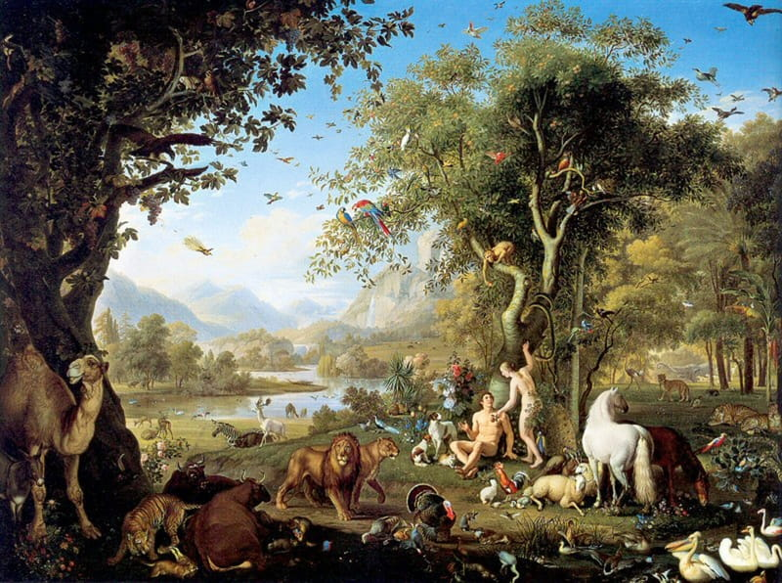
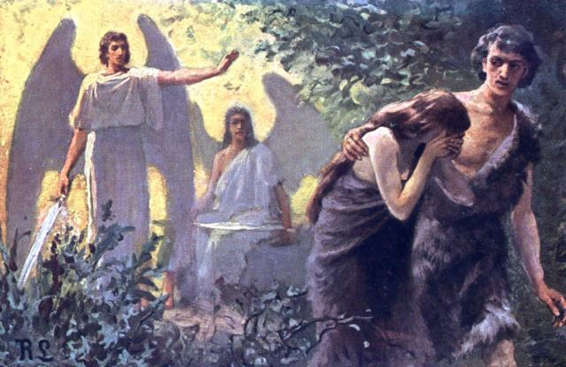
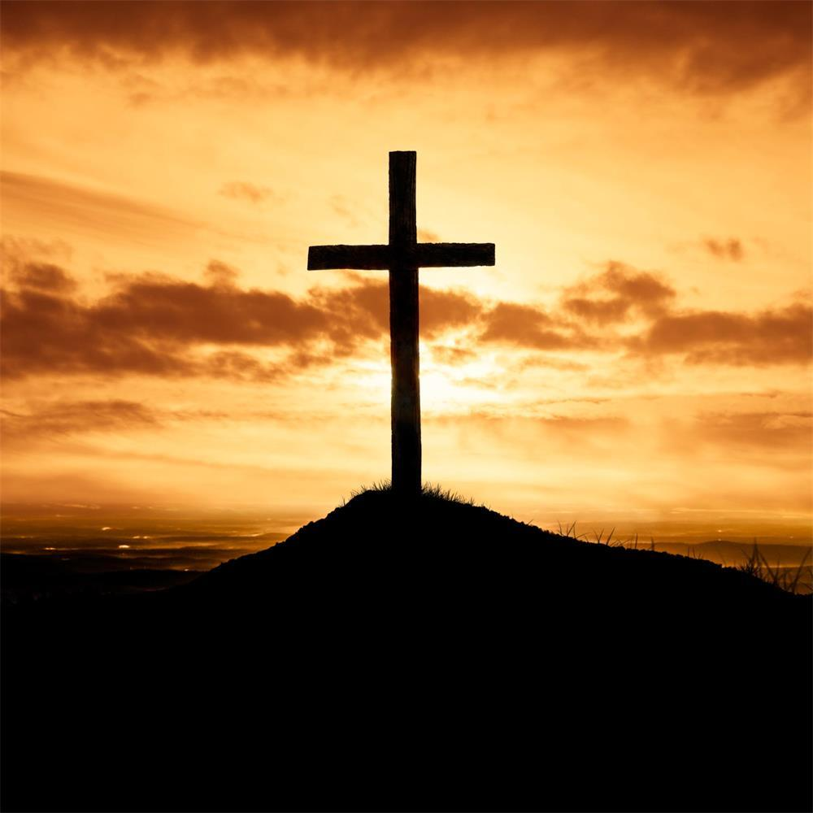
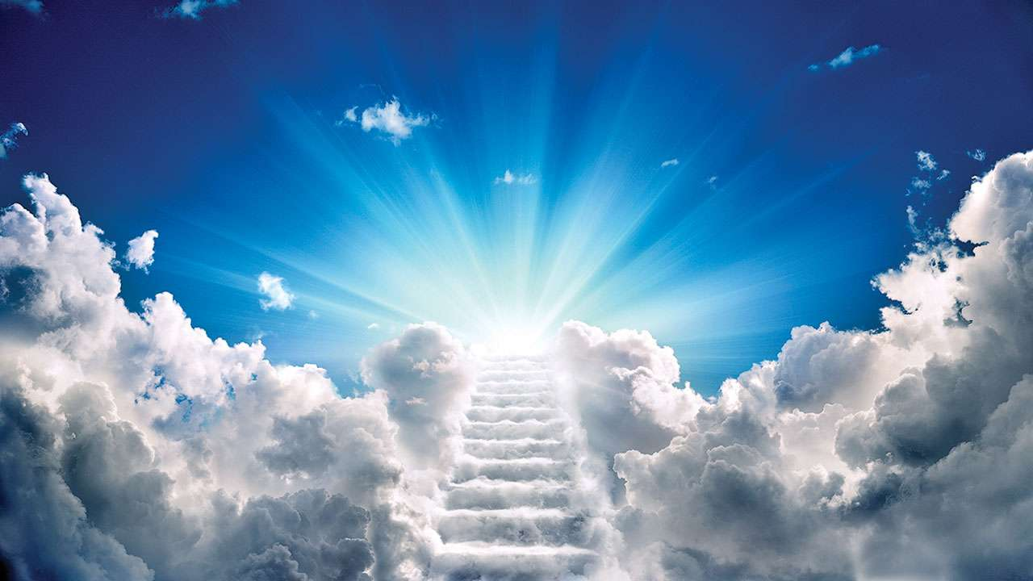
Human nature in its fourfold state (Boston)
Innocence
Man did not sin
Nature
Man could only
sin by his fallen
nature
Grace
Man is capable of not sinning by his new nature
Eternal state
Man cannot sin

Slide 26
God and sin
Q: Is God the author of sin?
We know that God works all things according to the counsel of His will
God by definition is good, and what He does is also good
God allowed the Fall, and yet God is not the author of sin
This is a mystery like election or the Trinity
"God cannot be tempted with evil, neither tempts he any man" (James 1:13)
"The Lord is righteous in all His ways, and holy in all His works" (Psalm 145:17)

Slide 27
Adam and Jesus
Adam was a real person, just as Jesus also was
"And so it is written, 'The first man Adam became a living being.' The last Adam became a life-giving spirit." (1Cotinthian 15:45)
So many people are okay with Jesus taking away their sin but not okay with accepting Adam's sinful nature!
Rights and responsibilities!
Since Adam fell, God then made a covenant of grace with man
Q: Is the covenant of life still in effect today?

Slide 28
Question #13
Q. Did our first parents continue in the first estate wherein they were created?
A. Our first parents, being left to the freedom of their own will, fell from the estate wherein they were created, by sinning against God.

Slide 29
What does the Bible say?
"So when the woman saw that the tree was good for food, that it was pleasant to the eyes, and a tree desirable to make one wise, she took of its fruit and ate. She also gave to her husband with her, and he ate. Then the eyes of both of them were opened, and they knew that they were naked; and they sewed fig leaves together and made themselves coverings. And they heard the sound of the Lord God walking in the garden in the cool of the day, and Adam and his wife hid themselves from the presence of the Lord God among the trees of the garden." (Genesis 3:6-8)

Slide 30
The tree of life as a sacrament
A sacrament is a holy ordinance wherein by sensible signs, Christ and the benefits of the new covenant are represented, sealed and applied to believers
Normally baptism and the Lord's Supper
The tree of life was a symbol of eternal life
In the Middle East it was always green
Roman Catholic sacraments work ex opere operato (they work by themselves)
Rather, sacraments are efficacious by the institution and working of Christ
If Adam refrained from eating from the tree he lived

Slide 31
Liberty and ability
Q: When we meet Adam in heaven, will you blame him for the Fall?
Adam fell even though he had a perfect nature
But we have a fallen nature, and thus we would have done the same as he did, or even worse
Adam had the liberty of either eating or not eating
They also had the ability to choose either to be obedient
or disobey
Now in our fallen nature we have lost this ability
"They have all turned aside; they have together become unprofitable; there is none who does good, no, not one." (Romans 3:12)

Slide 32
Adam and Eve were real people
Jesus said so (Matthew 19:4), and Paul (Romans 5:12-21)
It is harder to imagine that all of life sprang into existence from a single cell
Adam could have contained many different gene versions (alleles) in his reproductive cells
We all have more or less of a single skin color pigment (melatonin)
All of humanity descends from Noah's three sons
Human Y chromosome variability is almost non-existent
Noah and genetics
Mitochondrial Eve

Slide 33
What they didn’t tell you about human-chimp DNA similarity
Human DNA
GCGAGTGAAGTGCTGTAGTCGTACTCGTAGTCGTTGCTAGTCACAGCGTGCAG
99% similar!
NOT similar!
NO match!
GCGAGTGTAGTGCTGTAGTCGTAGTCGTAGTCGTAGCTACCCTAG
Chimp DNA
Only 82% similar OVERALL!!
Notes:
Hundreds of gene are also missing from chimp which are present in human.
The 99% figure comes from Jon Alquist, who is now a creationist and rejects this number.

Slide 34
Homework! :-)
Challenge your non-believing friend's views on evolution, and tell us what happened
Good resources at creation.com
Memorize the following verses:
Philippians 2:12-13
Ephesians 1:11
Psalm 91:7
Luke 17:10
Psalm 145:17
Romans 3:12

